Slide 1
OVERCLOCKING IN COMPUTING

Slide 2
Overclocking a component in your computer usually the CPU, and occasionally the graphics card makes your computer run faster than it was originally intended
This can improve your computer's performance without spending money to upgrade or enhance your PC.
Overclocking is particularly popular among gamers that want to get the most out of their high-end rigs a bit more power out of an older system
NOTE: It's also important to remember that not every computer can be overclocked, the process requires specific hardware to be effective.
And users should be aware that overclocking can push your computer to its limits and potentially shorten its lifespan.

Slide 3
What is overclocking?
Overclocking means increasing the speed at which a CPU or other hardware component works to perform calculations.
Different computer processor chips run at different speeds this is known at their "clock speed." A higher clock speed means a CPU can run more operations per second, and thus run your computer faster.
What does overclocking do, exactly?
Overclocking allows you to run your processor at higher clock speeds than originally intended.
This lets you do resource-intensive tasks faster and more smoothly, such as editing videos or photos or gaming

Slide 4
Risks of overclocking
Voided warranty
Because overclocking is often considered a form of device modification, overclocking may void your computer’s warranty.
Instability issues
Overclocking can cause your device to become unstable, resulting in crashes and freezing
Overheating problems
Another possible risk with overclocking is the potential for increases in temperature and power usage causing your device to overheat.

Slide 5
Is overclocking safe?
These days, overclocking is very safe, because modern computers have built-in safeguards to power down or turn off components if they get too hot.
While overclocking means pushing your hardware beyond its official limits, with modern materials, your hardware will likely have no problems.
How to troubleshoot overclocking problems
Test device stability
Monitor hardware temperatures
Change your settings
Update drivers and BIOS

Slide 6
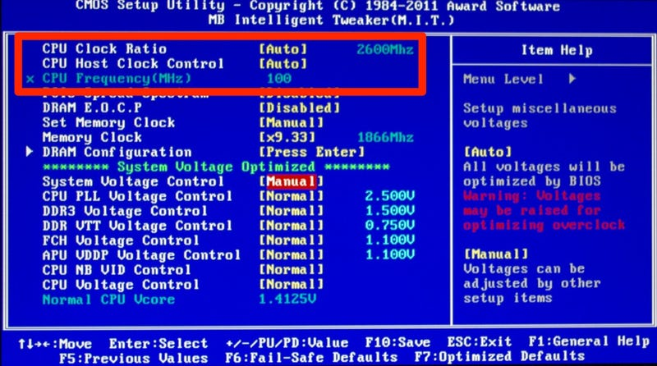

Slide 7
Processor (CPU)
A processor (CPU) is the logic circuitry that responds to and processes the basic instructions that drive a computer.
The CPU is seen as the main and most crucial integrated circuitry (IC) chip in a computer, as it is responsible for interpreting most of computers commands.
Parts of the CPU
Control Unit
ALU
Registers
Operations of the CPU
Fetch- is the operation which receives instructions from program memory from a systems RAM
Decode- is where the instruction is converted to understand which other parts of the CPU are needed to continue the operation.
Execute- is where the operation is performed.

Slide 8
Causes of CPU Failures
It Has Reached Its Age Limit
Every machine has its own set of limitations. A computer is said to be in its final years of life if it is five years old or older.
Technology has also advanced since the computer originally came out, so the cost to repair may not outweigh the cost to replace.
It Is Overheating
Extremely high temperatures can overheat and kill your CPU. If your computer has an inadequate cooling mechanism and the temperatures exceed 176 °F, it can lead to these problems.
Overclocking It
Not all computer processors are the same. Don't use a dual-core processor to accomplish the job of an eight-core processor.
Power Surges
Any significant voltage spike can make a CPU inoperable, regardless of whether it was caused by a poor power supply or by a bolt of lightning. Consider purchasing a surge protector and battery backup to avoid this problem.

Slide 9
Indicators of a failing CPU
Computer Freezes
One of the most common signs of CPU failure is the random freezing of your computer, usually after just logging into the operating system.
The system won’t respond to any of your instructions.
Booting Issues
Normally you will hear a beep sound when your computer is powered on. However, in case of a CPU failure, there can be booting issues such as blank screens
Computer Automatically Turns Off
Beep alerts
Each time the computer is booted, it checks whether all the components of the PC are functioning properly. This is called the POST test. If you hear irregular beep sounds, a failing CPU can be one of the reasons.
External Appearances of Damage
A computer can show signs of CPU damage even without booting it up. Overheating can cause damages that may be visible externally.
Blue Screen with Error Code

Slide 10
Diagnosing and Repairing Faulty CPU in a Computer
If your computer is not booting up, crashing frequently, or overheating, you might have a problem with your CPU.
The CPU, or central processing unit, is the brain of your computer that executes instructions and performs calculations.
Identify the symptoms
Identifying the symptoms of a faulty CPU is the first step.
Test the CPU
The second step is to test the CPU using some diagnostic tools. You can use a software tool, such as CPU-Z, to check the CPU model, speed, temperature, and voltage.
Remove the CPU
Remove the CPU from the motherboard. You will need to open the computer case, disconnect the power cord, and ground yourself to prevent static electricity.

Slide 11
Replace the CPU
Replace the CPU with a new or compatible one. You will need to check the motherboard manual or website to find out what type of CPU socket and chipset you have, and what models of CPU are supported.
Troubleshoot the CPU
If you experience any issues with your CPU, the sixth step is to troubleshoot it.
Resetting the BIOS or UEFI settings to the default values, updating the BIOS or UEFI firmware to the latest version and updating device drivers and operating system to the latest version are all possible solutions.

Slide 12
Make notes on;
Differentiate between RAM and ROM
The use of memory in a computer system and how the amount of memory affects the performance of a computer.
What is an operating
Steps in installing the operating system (like windows 7) on laptop computer or tablet
How does the operating system finds data on a disk.
What is troubleshooting in computing and list the steps in the troubleshooting process

